Slide 1


Computational notebooks for more openness, reproducibility, and productivity in research
Dr. Ludmilla Figueiredo Data & Code Curator (iBID, iDiv) Intro to Julia workshop 23.08.2024
A minimal setup to get you started

Slide 2
Agenda
Motivation
The kit
Practical session
Q&A

Slide 3
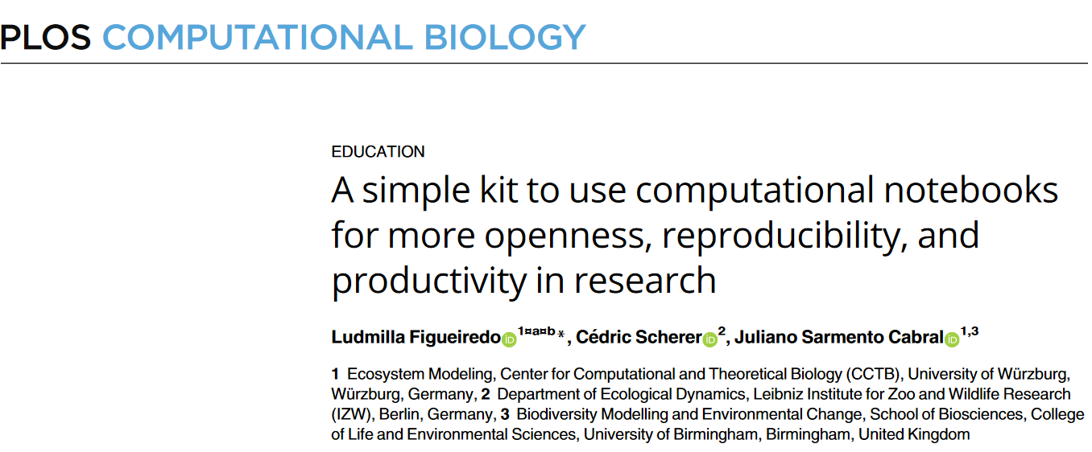
Motivation | The kit | Practical session | Q&A
https://doi.org/10.1371/journal.pcbi.1010356
ludmilla.figueiredo@idiv.de

Slide 4
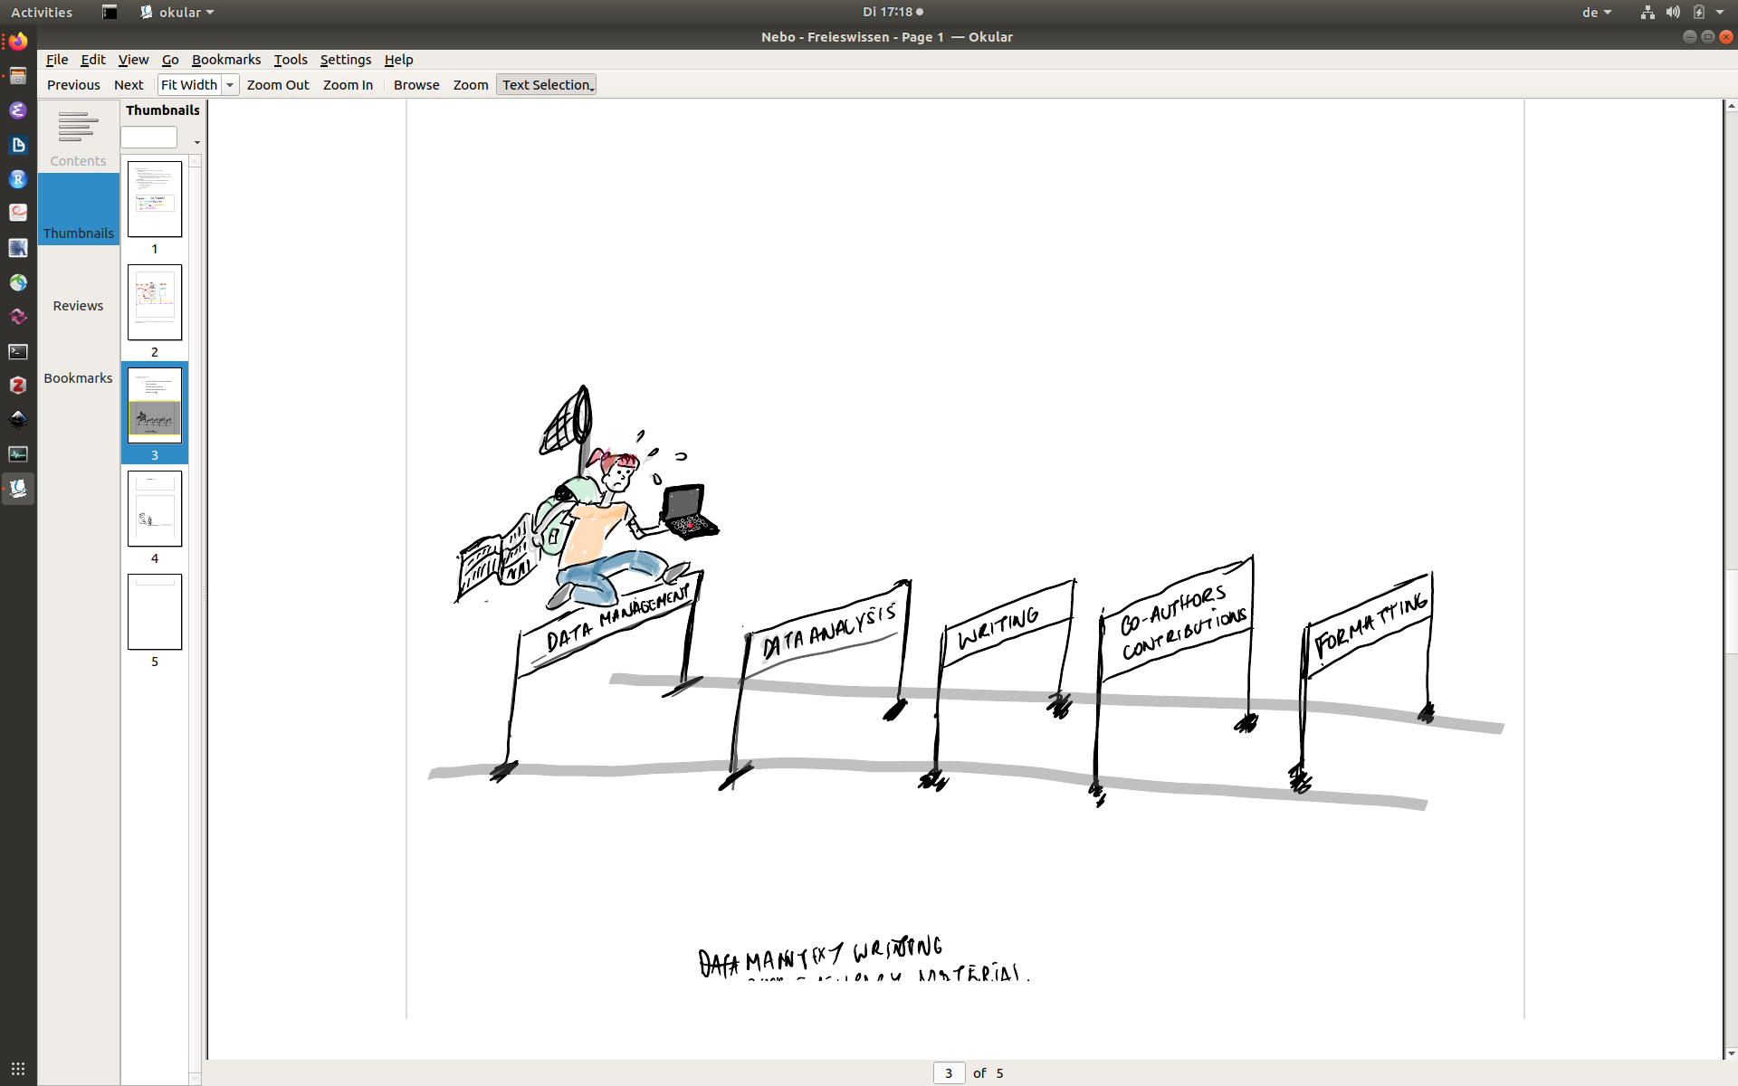
Motivation | The kit | Practical session | Q&A
Facilitate traceability and reproducibility
CC-BY Ludmilla Figueiredo
ludmilla.figueiredo@idiv.de

Slide 5

Motivation | The kit | Practical session | Q&A
*
Imming & Tennant (2018)
*not a justification for exorbitant open access fees
ludmilla.figueiredo@idiv.de

Slide 6

Motivation | The kit | Practical session | Q&A
Facilitate traceability and reproducibility
https://xkcd.com/927
“minimal” setup
ludmilla.figueiredo@idiv.de

Slide 7
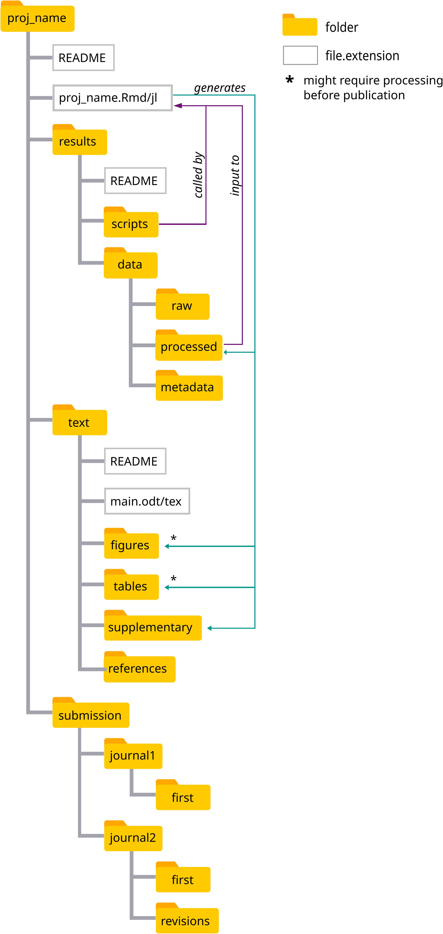
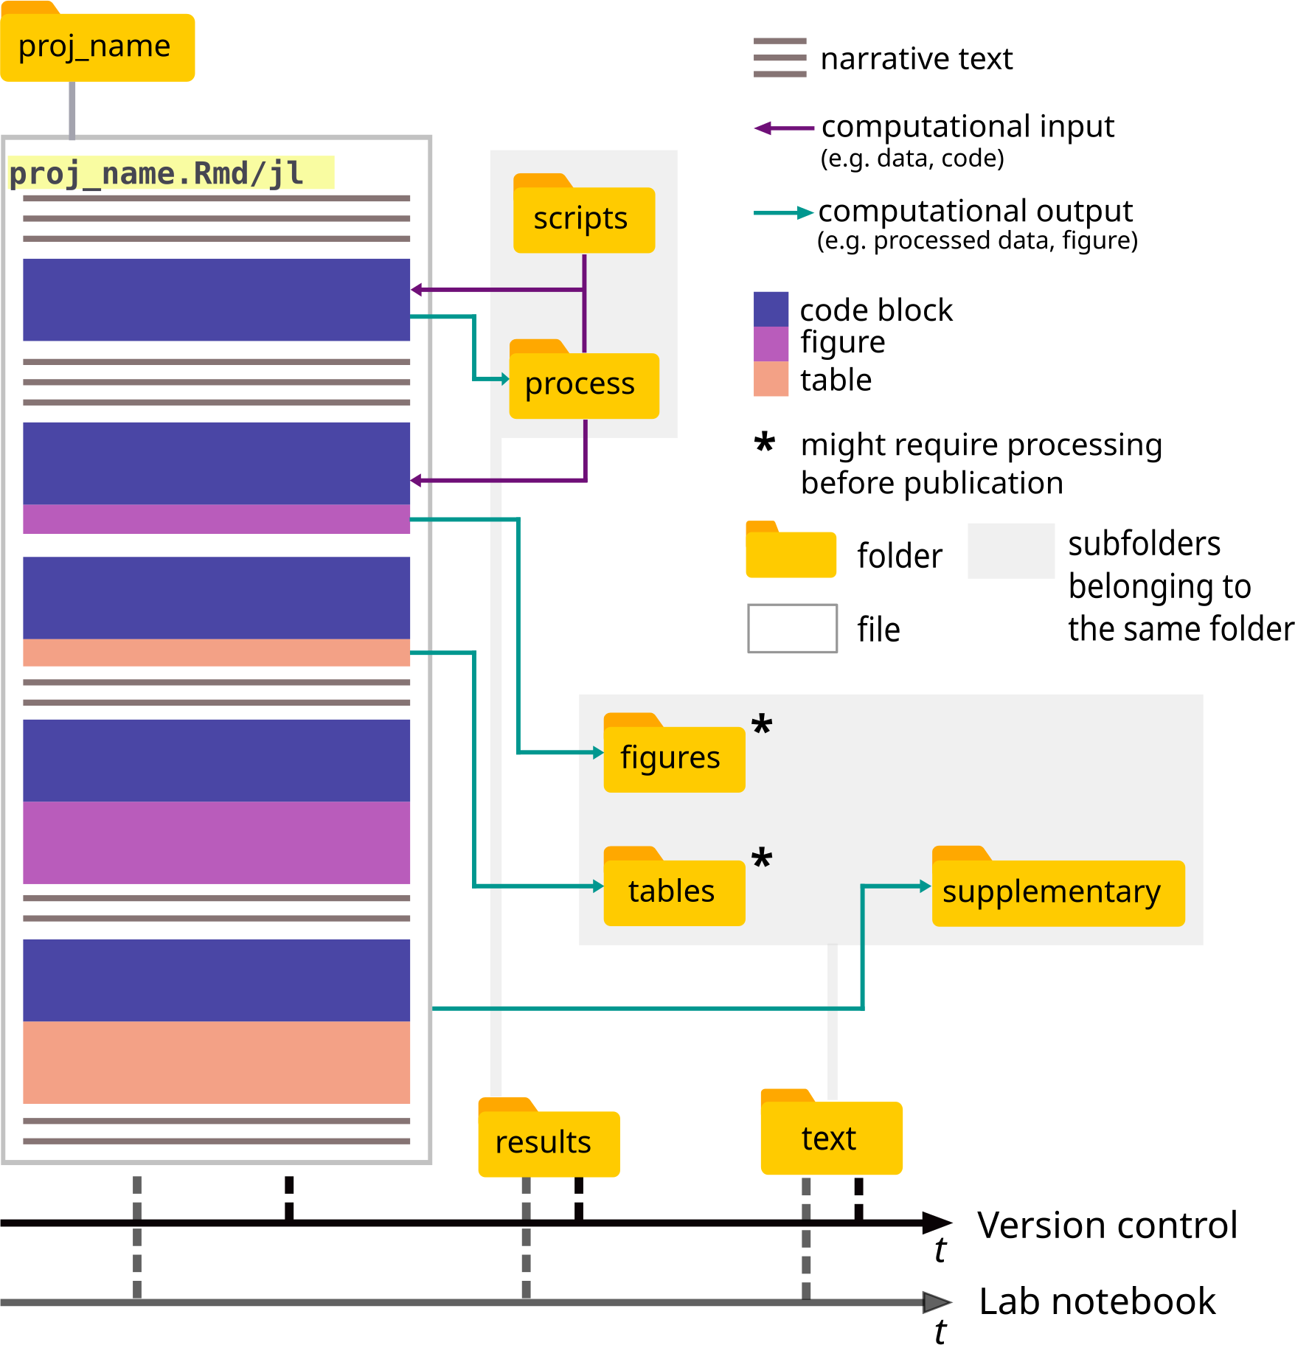
Motivation | The kit | Practical session | Q&A
Contents
Direct download
R/Python:
set_kit.R
Julia:
set_kit.jl
ludmilla.figueiredo@idiv.de

Slide 8
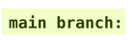
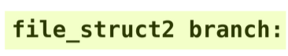
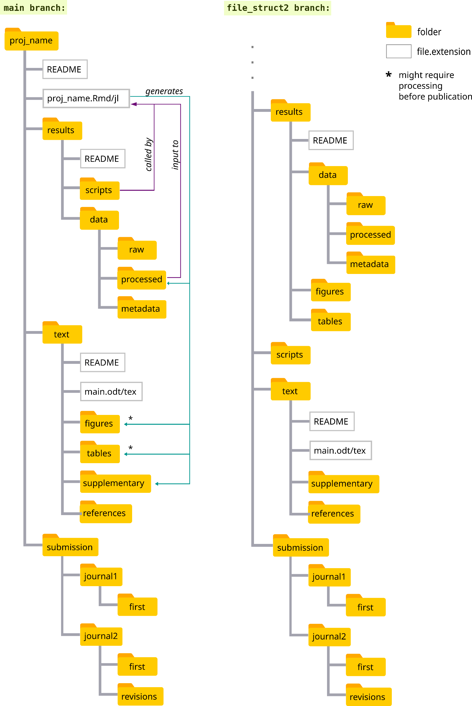
Motivation | The kit | Practical session | Q&A
New: Alternative file structures

Slide 9
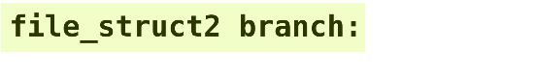
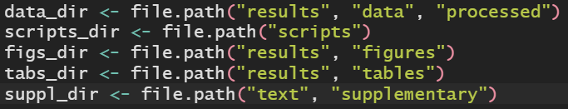
Motivation | The kit | Practical session | Q&A
“Programmatically” fast
Use relative paths to access folders

Slide 10
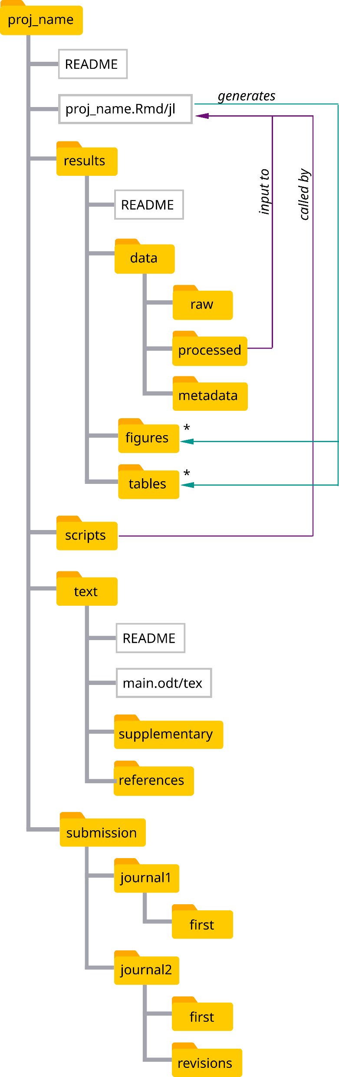
Motivation | The kit | Practical session | Q&A
File structure
ludmilla.figueiredo@idiv.de

Slide 11
Motivation | The kit | Practical session | Q&A
File structure
Identify the project
How to cite
License of use (if not specific file)
ludmilla.figueiredo@idiv.de

Slide 12
Motivation | The kit | Practical session | Q&A
File structure
ludmilla.figueiredo@idiv.de

Slide 13
Motivation | The kit | Practical session | Q&A
File structure
ludmilla.figueiredo@idiv.de

Slide 14
Motivation | The kit | Practical session | Q&A
File structure
*not under version control in git
ludmilla.figueiredo@idiv.de

Slide 15
Motivation | The kit | Practical session | Q&A
File structure
*not under version control in git

Slide 16
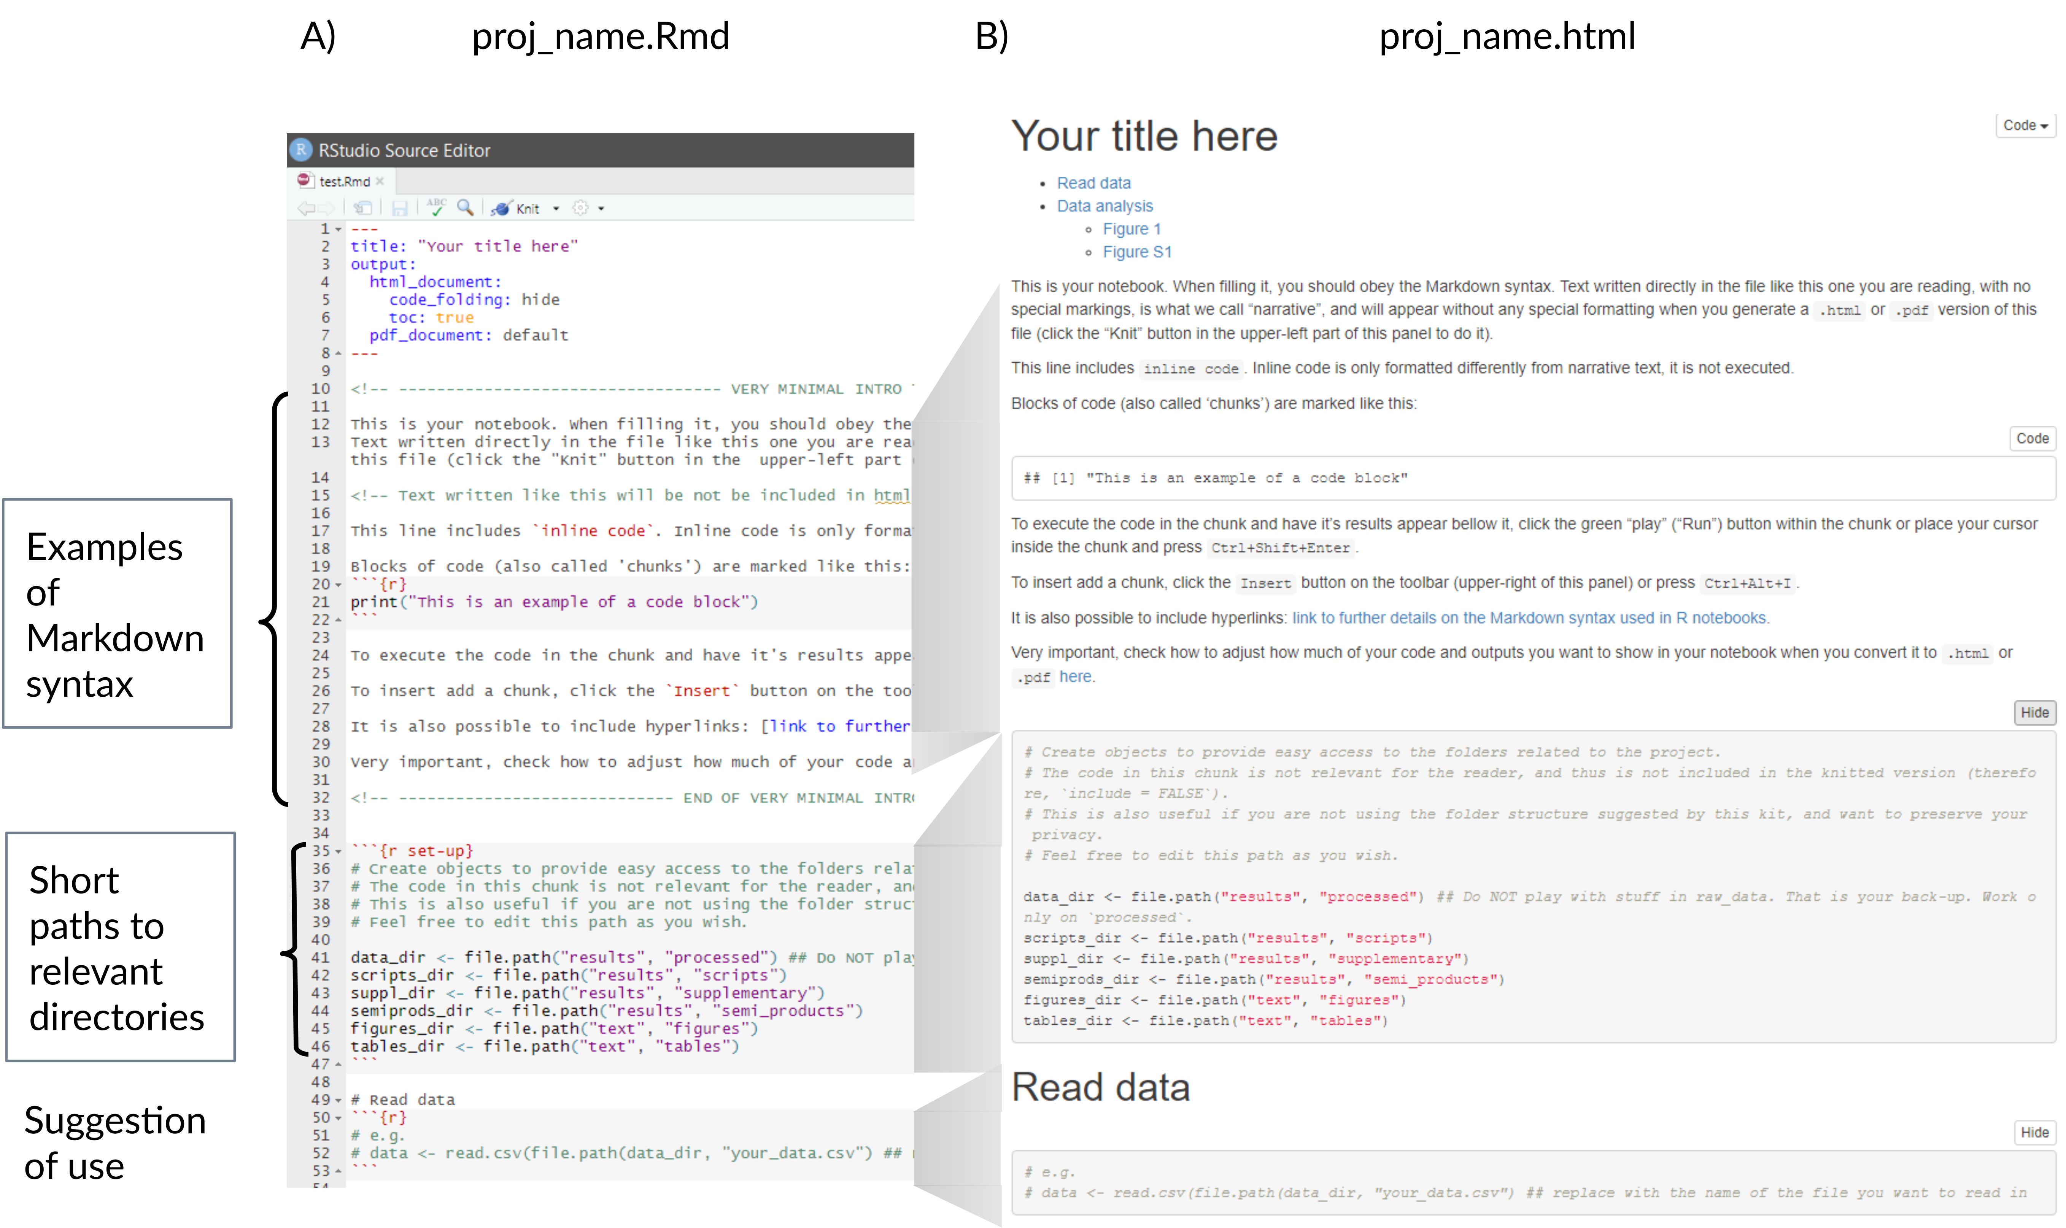
Motivation | The kit | Practical session | Q&A
One notebook to rule them all
A) What you edit
B) What the reader sees

Slide 17
Motivation | The kit | Practical session | Q&A
One notebook to rule them all

Slide 18
Motivation | The kit | Practical session | Q&A
One notebook to rule them all
1

Slide 19
Motivation | The kit | Practical session | Q&A
One notebook to rule them all
2

Slide 20
Motivation | The kit | Practical session | Q&A
One notebook to rule them all
3

Slide 21
Motivation | The kit | Practical session | Q&A
One notebook to rule them all
4
2/5

Slide 22
Motivation | The kit | Practical session | Q&A
One notebook to rule them all
This is a suggestion.
2/5

Slide 23
Motivation | The kit | Practical session | Q&A
Wrap-up
Make a point about licensing and versioning the “final” version of the code
ludmilla.figueiredo@idiv.de

Slide 24
Motivation | The kit | Practical session | Q&A
Demo

Slide 25
Motivation | The kit | Practical session | Q&A
LICEEEEEENSE

Slide 26
Motivation | The kit | Practical session | Q&A
Julia Documentation?

Slide 27
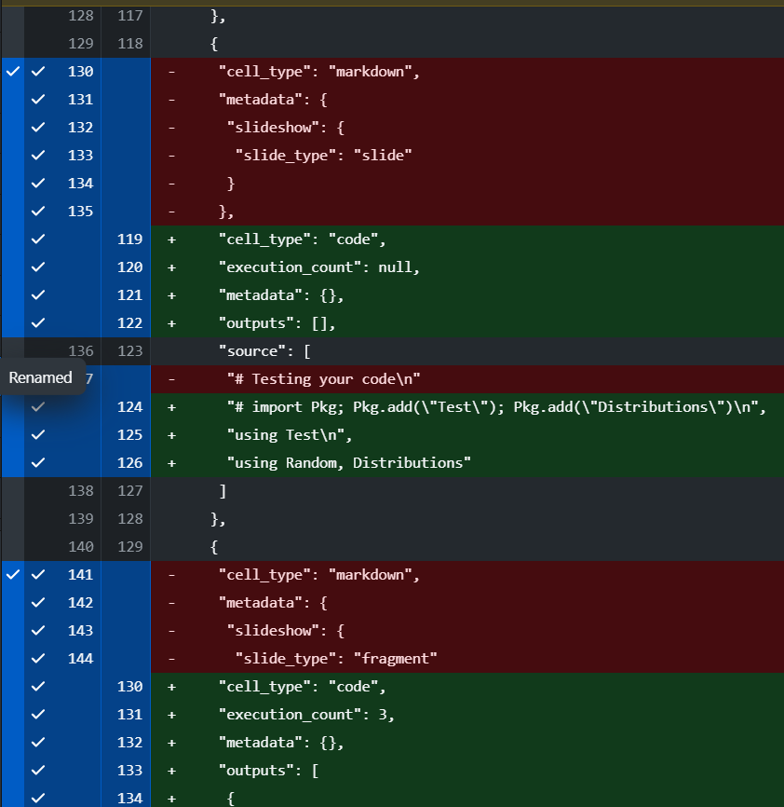
Motivation | The kit | Practical session | Q&A
Somewhat convoluted Git diff

Slide 28
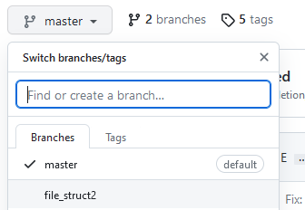
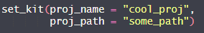
Motivation | The kit | Practical session | Q&A
Data:
https://tinyurl.com/dataGfOe2023-1
Kits:
https://tinyurl.com/notebooksGfOe2023
https://tinyurl.com/dataGfOe2023-2
Don’t forget to choose between the two file structures (see README)
Code:
https://tinyurl.com/codeGfOe2023
Exercise:
Download and place the data/metadata in their respective directories
Download the code and use it in the notebook (as script or not 😉)
(Suggestion: Fit your projects in the structure)
!
Where you save your projects, not the same as set_kit.R/jl.

Slide 29

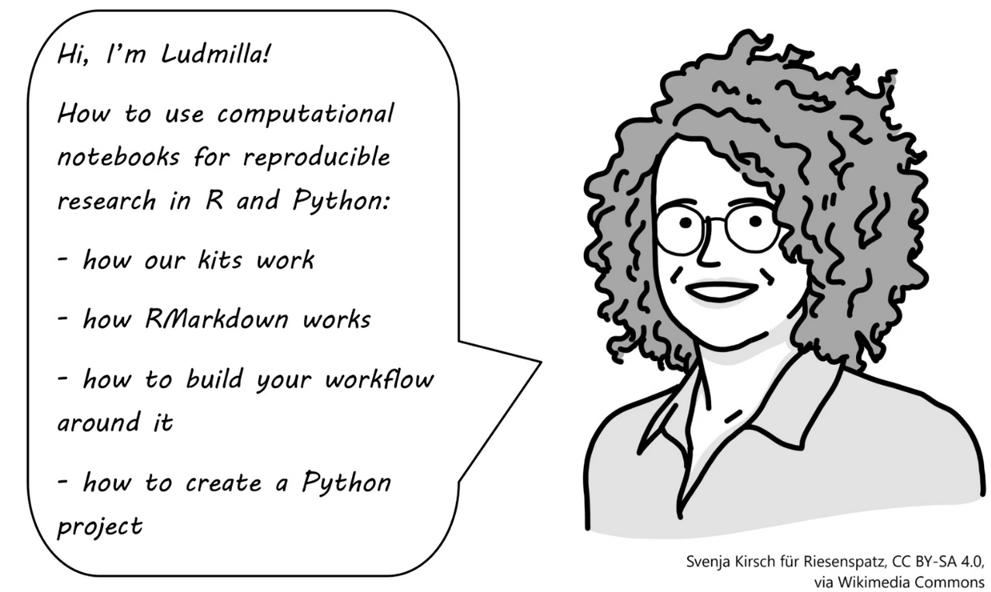
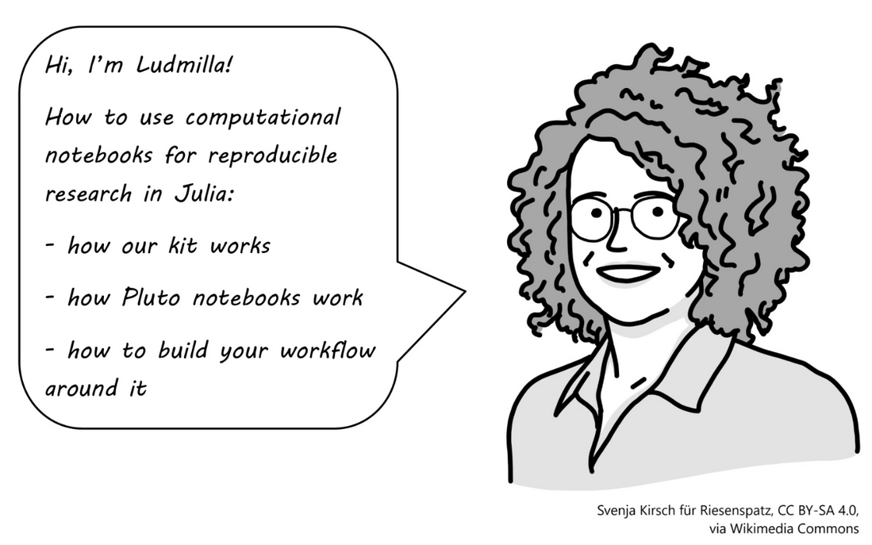



Motivation | The kit | Practical session | Q&A
Next steps
https://github.com/FellowsFreiesWissen/computational_notebooks
ludmilla.figueiredo@idiv.de

Slide 30
Thank You!

